Slide 1
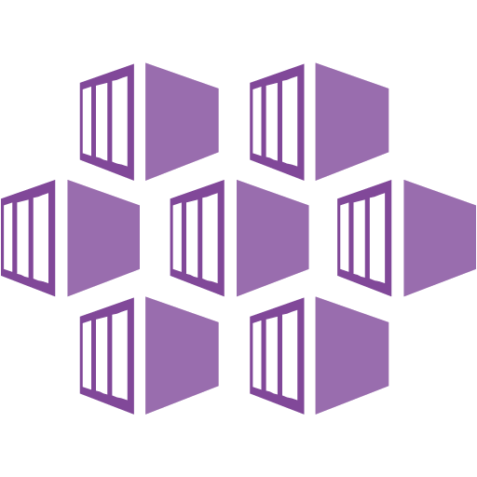
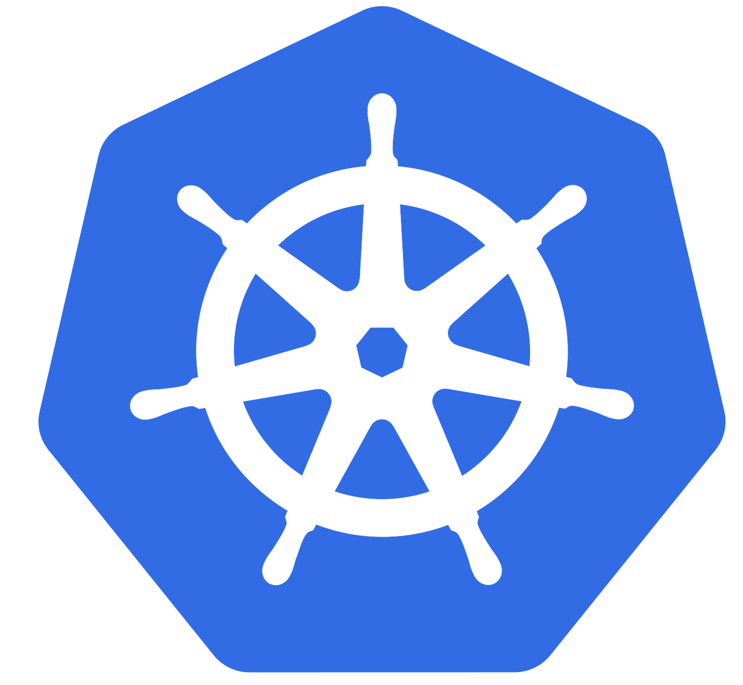
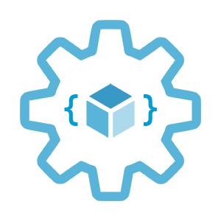

Introduction to Azure Kubernetes Service (AKS)
Infrastructure as Code User Group Oslo
02.03.2021
Evgeny Borzenin

Slide 2
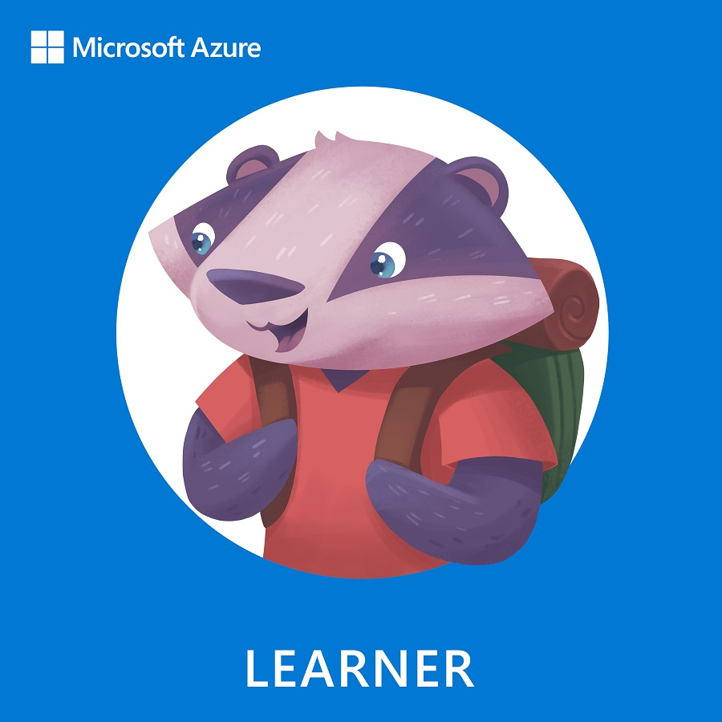
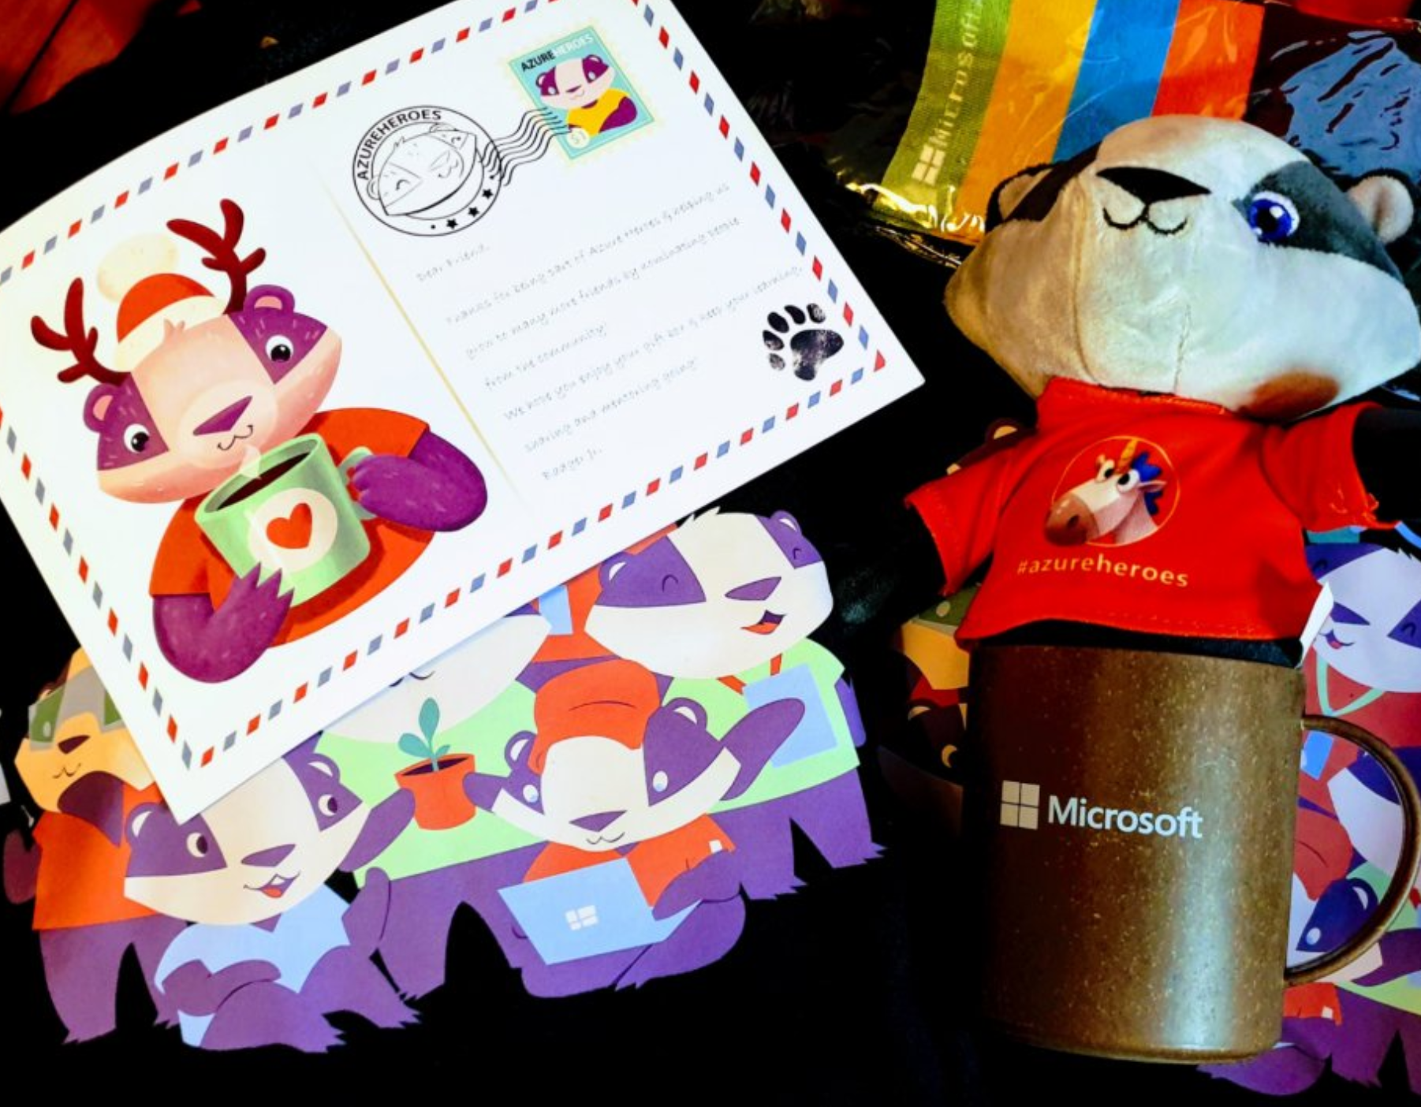
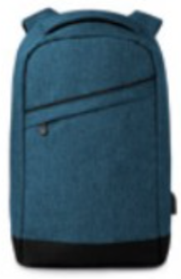


Learn more about AKS https://aka.ms/azure-aks
Get your next Learner digital badge of Azure Heroes program https://aka.ms/digital-badge
Win a cool Microsoft backpack!
Don’t forget to add Microsoft Azure skill to your LinkedIn account to stay connected with a developer community
+ Microsoft Azure
We post the latest announces about free events for the developers in Norway on our official Twitter account
@MSDevNo

Slide 3
Infrastructure as Code User Group 2021 roadmap
AKS workshops:
AKS and Kubernetes 101
Advanced AKS configuration (WIP – ETA end of March)
Service mesh with linkerd
Monitoring AKS cluster
AKS application deployment strategy
AKS security
Use Pulumi to provision and configure AKS cluster (???)

Slide 4
Infrastructure as Code User Group 2021 roadmap
“regular” events (work in progress)
17.03 – AKS at Norway – collaborative project with devreal.io
GitOps vs Pulumi vs Terraform
+ work in progress
If you have any good AKS / Kubernetes / IaC story – welcome to share!

Slide 5
Practical information
Mix of slides and labs with focus on labs
I don’t have moderator
Let’s help each other, the one who finished earlier can help others
Keep the same resource names as in labs -> easier to troubleshot
Share your screen if you stack with something
Labs are available after the event

Slide 6
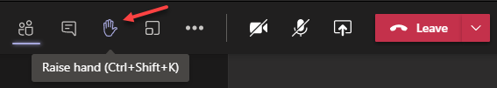
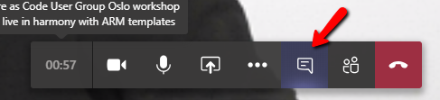

Microsoft Teams 101
Mute your mic (but don’t forget to unmute when you speak)
Feel free to use video
«Rise your hand» if you need some attention
Conversation/chat
If you want to have private discussion, find evgeny@enso.no and start chat with me
Share screen

Slide 7
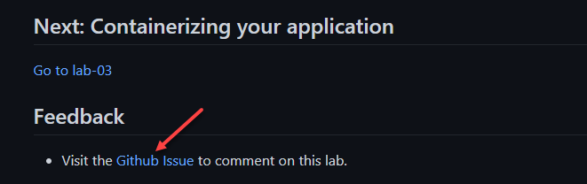
Practical information
Each lab is time-boxed
When you completed a lab, please post to the Conversation channel
lab-01 (lab-02, lab-03 etc…)
Labs will be available after the event
Feel free to contribute to the labs content by fixing gramma, typos, wrong commands etc..
Feel free to comment on each lab

Slide 8
Workshop agenda
Slides - Kubernetes and AKS introduction (10 min)
Lab-01 - AKS setup (15 min)
Lab-02 - setting up you shell for better AKS/kubectl experience (15 min)
Slides - Introduce our "guinea pig" app (10 min)
Lab-03 - Containerizing your application (15 min)
Pause
Slides - Pods, Namespaces (10 min)
Lab-04 - Creating, managing and testing pods (15 min)
Slides - Readiness and Liveness probes (15 min)
Lab-05 - Readiness and Liveness probes (15 min)
Slides - Deployments (5 min)
Lab-06 - Deployments (15 min)
Pause
Slides - Services, Labels, Selectors (10 min)
Lab-07 - Creating and Managing Services (15 min)
Slides - Configmaps and secrets (5 min)
Lab-08 - Configmaps and secrets (15 min)
Lab-09 - AKS Kubernetes resources at the Azure portal (15 min)
Lab-10 - Cleaning up (5 min)

Slide 9
Kubernetes and AKS introduction

Slide 10
What is Kubernetes (k8s)?
Kubernetes is a Container Orchestration System and cluster technology
Manage applications, not machines
Open source, open API container orchestrator
Inspired by Google’s experiences and internal systems
Greek for pilot or Helmsman – the person who steers a ship
Kubernetes -> k(ubernete)s -> len(ubernete) = 8 -> k8s
Notes:
Kubernetes is an open source project container automation framework.
Kubernetes provides an open, pluggable API that can work with containers across multiple cloud providers.
Kubernetes is based on learnings from how Google itself has been running applications and containers, internally.
3 Google employee in 2014 and in production v1 in 2015
These learnings have given rise to new primitives, new ways of looking at orchestrating the cloud in order to abstract away the underlying machines. So that you can Manage applications, not machines

Slide 11
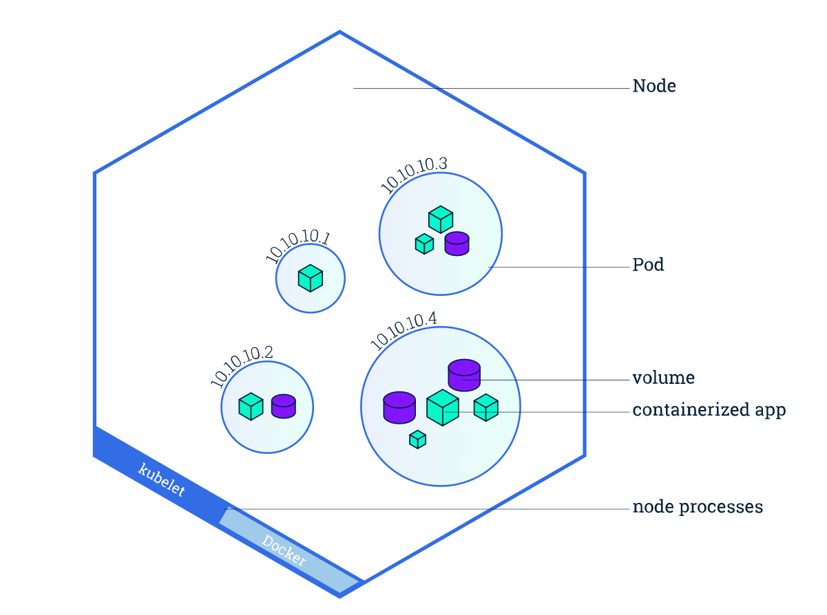
Kubernetes concepts
Nodes
Pods
Desired state (Imperative vs. Declarative)
Deployments
Services
Image from https://kubernetes.io/docs/tutorials/kubernetes-basics/explore/explore-intro/

Slide 12
K8s 101: Nodes
Nodes are machines (VM) in your cluster
Nodes can come and go
Eventually, the nodes will host your applications
Node1
Node2
Node3

Slide 13
K8s 101: Pods
Pods are the smallest deployment unit
A single Pod can hold multiple containers
Node1
Node2
Node3
pod
pod
pod
pod
app-a
app-b
app-b
app-a
app-d

Slide 14
K8s 101: Desired State
Tell Kubernetes what you want, not what to do
Kubernetes always tries to steer the cluster to its desired state
You: “Hey, k8s, I want 3 replicas of app-a”
K8s: “Here are 3 replicas of app-a”
K8s: “Upps, one just died, I will try to find a node where I can spin up a new replica”
K8s: “Here are 3 replicas of app-a”

Slide 15
K8s 101: Deployment
Deployments are requirements you give to Kubernetes regarding your applications (Pods)
k8s: I need 2 replicas of app-a and 3 replicas of app-b
Node1
Node2
Node3
pod
pod
pod
pod
pod
app-a
app-b
app-b
app-a
app-b

Slide 16
K8s 101: Services
Services are an abstract way to expose an application running on a set of Pods
A Service has a name and maps to a dynamic set of Pods defined by a label selector
service-a
service-b
Node1
Node2
Node3
pod
pod
pod
pod
pod
app-a
app-b
app-b
app-a
app-b

Slide 17

Azure Kubernetes Service (AKS)
+
=
Notes:
Azure Kubernetes Service (AKS) is a managed Kubernetes offering that simplifies container-based application deployment and management.
Azure Kubernetes Service (AKS) provides a managed Kubernetes service that reduces the complexity for deployment and core management tasks, including coordinating upgrades.

Slide 18
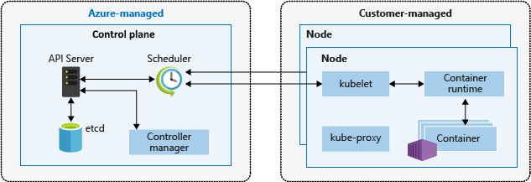
AKS cluster architecture
Image from https://docs.microsoft.com/en-us/azure/aks/concepts-clusters-workloads
Notes:
The AKS control plane is managed by the Azure platform, and you only pay for the AKS nodes that run your applications. AKS is built on top of the open-source Azure Kubernetes Service Engine (aks-engine).
When you create an AKS cluster, a control plane is automatically created and configured. This control plane is provided as a managed Azure resource abstracted from the user. There's no cost for the control plane, only the nodes that are part of the AKS cluster.
kube-apiserver - The API server is how the underlying Kubernetes APIs are exposed. This component provides the interaction for management tools, such as kubectl or the Kubernetes dashboard.
etcd - To maintain the state of your Kubernetes cluster and configuration, the highly available etcd is a key value store within Kubernetes.
kube-scheduler - When you create or scale applications, the Scheduler determines what nodes can run the workload and starts them.
kube-controller-manager - The Controller Manager oversees a number of smaller Controllers that perform actions such as replicating pods and handling node operations.

Slide 19
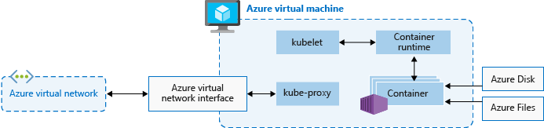
AKS nodes
Image from https://docs.microsoft.com/en-us/azure/aks/concepts-clusters-workloads
Notes:
To run your applications and supporting services, you need a Kubernetes node. An AKS cluster has one or more nodes, which is an Azure virtual machine (VM) that runs the Kubernetes node components and container runtime.
The kubelet is the Kubernetes agent that processes the orchestration requests from the control plane and scheduling of running the requested containers.
Virtual networking is handled by the kube-proxy on each node. The proxy routes network traffic and manages IP addressing for services and pods.
The container runtime is the component that allows containerized applications to run and interact with additional resources such as the virtual network and storage.

Slide 20
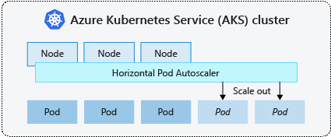
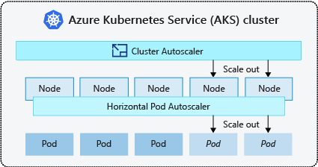
AKS scaling options
Manually scale pods or nodes
Horizontal pod autoscaler
Cluster autoscaler
https://docs.microsoft.com/en-us/azure/aks/concepts-scale

Slide 21






AKS scaling options
AKS
docker push
docker pull
ACR
Virtual Network
Resource Group
Log Analytics
Monitor

Slide 22
Lab-01, 02, 03

Slide 23
Pause

Slide 24
k8s 101: Pods

Slide 25
Pods
A Pod is an abstraction that represents:
a group of one or more application containers
Shared storage, as Volumes
Networking, as a unique cluster IP address
Information about image version and specific ports to use
10.240.0.3
pod
app-a
app-b
Config
map
Secrets
Notes:
A pod represents a single instance of an app running in Kubernetes. The workloads that you run on Kubernetes are containerized apps. Unlike in a Docker environment, you can't run containers directly on Kubernetes. You package the container into a Kubernetes object called a pod. A pod is the smallest object that you can create in Kubernetes.

Slide 26
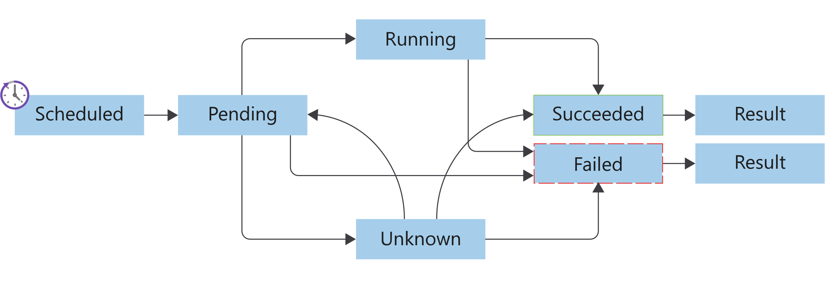
Pods lifecycle
Image from https://docs.microsoft.com/en-us/learn/modules/intro-to-kubernetes/3-how-kubernetes-works
Notes:
Kubernetes pods have a distinct lifecycle that affects the way you deploy, run, and update pods. You start by submitting the pod YAML manifest to the cluster. After the manifest file is submitted and persisted to the cluster, it defines the desired state of the pod. The scheduler schedules the pod to a healthy node that has enough resources to run the pod.
Pending
After the pod run is scheduled, the container runtime downloads container images, and starts all containers for the pod.
Running
The pod transitions to a running state after all of the resources within the pod are ready.
Succeeded
The pod transitions to a succeeded state after the pod completes its intended task, and runs successfully.
Failed
Pods can fail for various reasons. A container in the pod may have failed, leading to the termination of all other containers. Or, maybe an image wasn't found during preparation of the pod containers. In these types of cases, the pod can go to a failed state. Pods can transition to a failed state from either a pending state or a running state. A specific failure can also place a pod back in the pending state.
Unknown
If the state of the pod can't be determined, the pod is an unknown state.

Slide 27
Lab-04

Slide 28
k8s 101: Readiness and Liveness probes

Slide 29
Liveness probe
On every node is a daemon called a Kubelet
One of the Kubelet’s jobs is to ensure that pods are healthy
Kubelet sends out a liveness probe to a pod
app-a, are you alive?
No
Node
kubelet
pod
app-a

Slide 30
Liveness probe
If the Kubelet gets back multiple bad responses
app-a, restart!
Node
kubelet
pod
app-a

Slide 31
Liveness probe
This cycle then starts all over again
app-a, are you alive?
Yes!
Node
kubelet
pod
app-a

Slide 32
Readiness probe
app-a is already alive
kubelet sends readiness probe
If app-a is not ready, wait and send new request
service-a
app-a, are you ready?
Node
kubelet
pod
pod
pod
app-a
app-a
app-a
Not yet

Slide 33
Readiness probe
This cycle then starts all over again
Send traffic to app-a
service-a
app-a, are you ready?
Node
kubelet
pod
pod
pod
app-a
app-a
app-a
Yes!

Slide 34
Lab-05

Slide 35
k8s 101: Deployments

Slide 36
Deployments
Drive current state towards desired state
app: app-a
replicas: 3
app: app-a
replicas: 1
Node1
Node2
Node3
Node3
pod
pod
pod
pod
app-a
app-a
app-a
app-a

Slide 37
Rolling Update
service-a
Node1
Node1
Node1
pod
pod
pod
pod
app-a: v1
app-a: v1
app-a: v1
app-a: v2

Slide 38
Rolling Update
service-a
Node1
Node1
Node1
pod
pod
pod
pod
app-a: v1
app-a: v1
app-a: v1
app-a: v2

Slide 39
Rolling Update
service-a
Node1
Node1
Node1
pod
pod
pod
pod
app-a: v1
app-a: v2
app-a: v1
app-a: v2

Slide 40
Rolling Update
service-a
Node1
Node1
Node1
pod
pod
pod
pod
app-a: v1
app-a: v2
app-a: v1
app-a: v2

Slide 41
Rolling Update
service-a
Node1
Node1
Node1
pod
pod
pod
pod
app-a: v2
app-a: v1
app-a: v2
app-a: v2

Slide 42
Rolling Update
service-a
Node1
Node1
Node1
pod
pod
pod
pod
app-a: v2
app-a: v1
app-a: v2
app-a: v2

Slide 43
Rolling Update
service-a
Node1
Node1
Node1
pod
pod
pod
app-a: v2
app-a: v2
app-a: v2

Slide 44
Lab-06

Slide 45
Pause

Slide 46
k8s 101: Services, Labels, Selectors

Slide 47
Services
Persistent Endpoint for Pods
Use Labels and Selectors to select Pods
service-a
pod
pod
pod
app-a
app-a
app-a
labels:
app: app-a
labels:
app: app-a
labels:
app: app-a
Notes:
A Kubernetes service is a Kubernetes object that provides stable networking for pods. A Kubernetes service enables communication between nodes, pods, and users of your app, both internal and external, to the cluster.
Kubernetes assigns a service an IP address on creation, just like a node or pod. These addresses get assigned from a service cluster's IP range. An example is 10.96.0.0/12. A service is also assigned a DNS name based on the service name, and an IP port.
Managing pods by IP address isn't practical. Pod IP addresses change as controllers re-create them, and you might have any number of pods running.

Slide 48
Labels and selector
selector:
app: app-a
pod
pod
pod
app-a
app-a
app-a
labels:
app: app-a
version: v1
labels:
app: app-a
version: v1
labels:
app: app-a
version: v2
Notes:
A service object enables you to target and manage specific pods in your cluster by using selector labels. You set the selector label in a service definition to match the pod label defined in the pod's definition file.

Slide 49
Labels and selector
selector:
app: app-a
version: v1
pod
pod
pod
app-a
app-a
app-a
labels:
app: app-a
version: v1
labels:
app: app-a
version: v1
labels:
app: app-a
version: v2

Slide 50
Lab-07

Slide 51
k8s 101: Configmaps and secrets
Notes:
We don’t want to hard code sensitive credentials directly into our code or configuration.
Secrets allow you to mount sensitive data as either a file in a volume, or directly into environment variables. The next few slides animates how it works in k8s. The same applicable for ConfigMaps

Slide 52
Secrets and ConfigMaps
kubectl create secret / kubectl cerate cm
Node
10.240.0.3
pod
kubelet
app-a
/etc/secrets
secret/
ConfigMap
Notes:
Kubernetes uses the same storage volume concept that you find when using Docker. Docker volumes are less managed than the Kubernetes volumes because Docker volume lifetimes aren't managed. The Kubernetes volume's lifetime is an explicit lifetime that matches the pod's lifetime. This lifetime match means a volume outlives the containers that run in the pod. However, if the pod is removed, so is the volume.

Slide 53
Lab-08, 09

